Slide 1
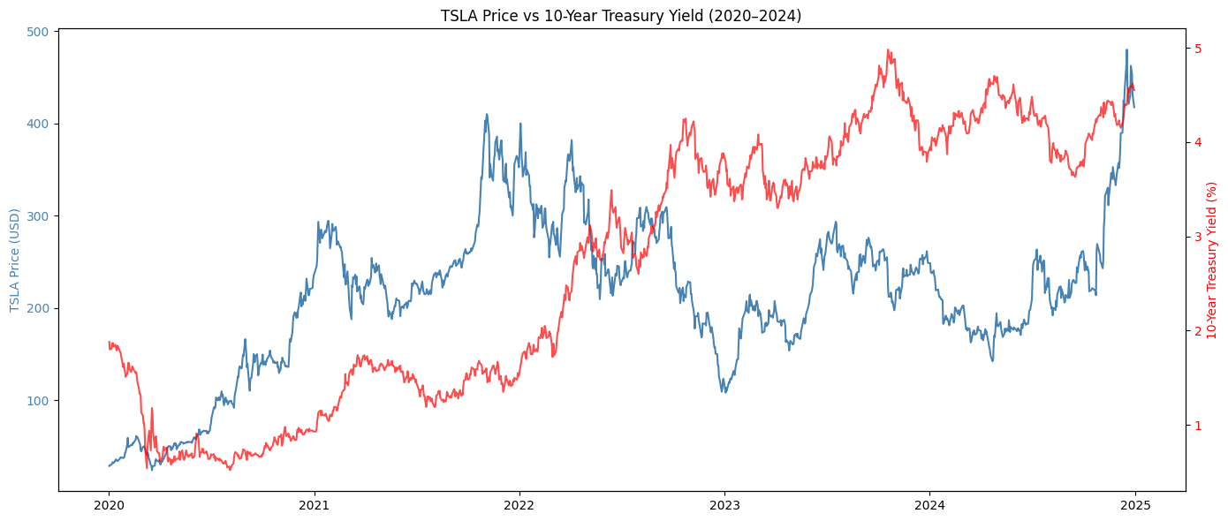
Does the Fed Move Tesla?
A Time-Series Analysis of Treasury Yields and TSLA Stock Returns
TSLA surged 1,300% during the low-rate era (2020–2021) and collapsed 70%+ as rates rose in 2022
Granger Causality Test confirms Treasury yield changes statistically predict TSLA returns at 95% confidence (p < 0.05 at lags 1, 2, 3 & 5)
VAR model forecasts modest positive TSLA returns as rate environment stabilizes into 2025
Andrew Freeman QM S26

